Slide 1
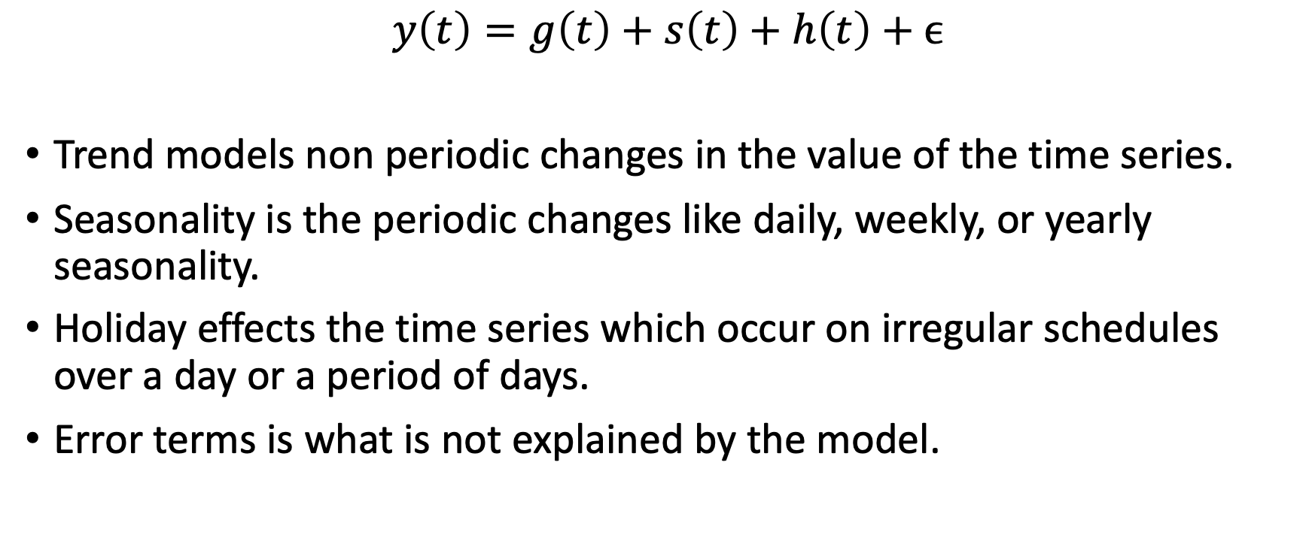
Prophet – structural time series model
Prophet = Trend + Seasonality + Holiday + error
$y\left(t\right)=g\left(t\right)+s\left(t\right)+h\left(t\right)+ϵ$
Trend models non periodic changes in the value of the time series.
Seasonality is the periodic changes like daily, weekly, or yearly seasonality.
Holiday effects the time series which occur on irregular schedules over a day or a period of days.
Error terms is what is not explained by the model.
Notes:
Here g(t) is the trend function which models non-periodic changes in the value of the time series, s(t) represents periodic changes (e.g., weekly and yearly seasonality), and h(t) represents the effects of holidays which occur on potentially irregular schedules over one or more days. The error term εt represents any idiosyncratic changes which are not accommodated by the model; later we will make the parametric assumption that εt is normally distributed.
This specification is similar to a generalized additive model (GAM) (Hastie & Tibshirani 1987), a class of regression models with potentially non-linear smoothers applied to the regressors.

Slide 2
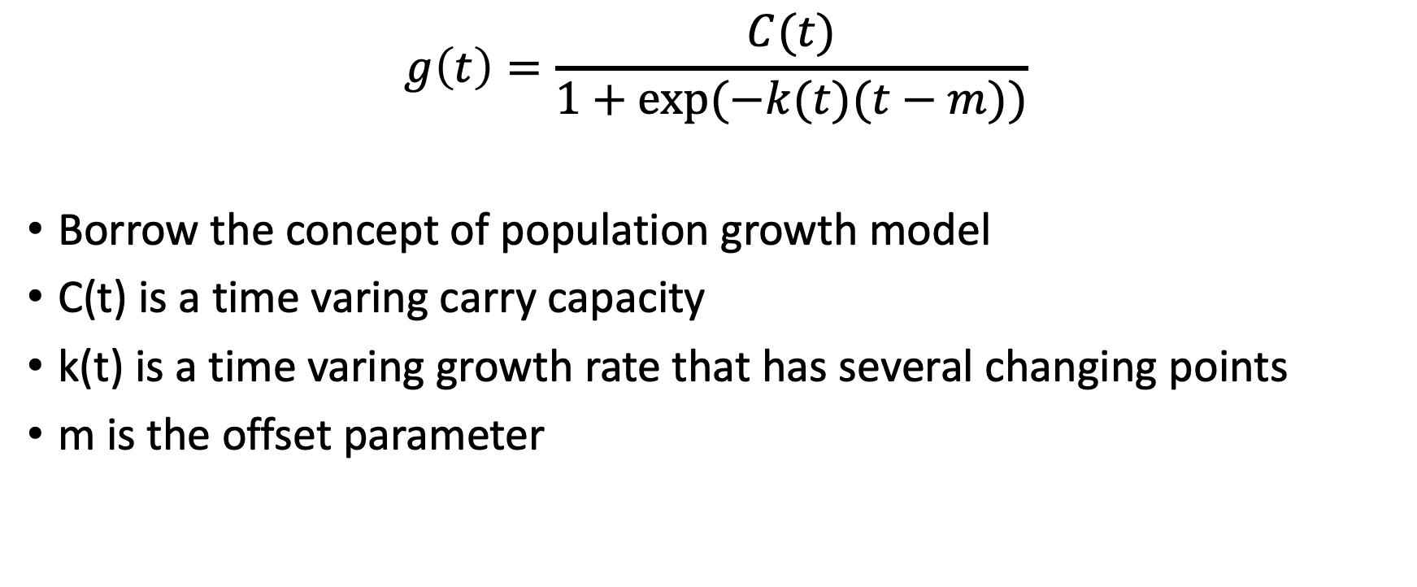
Trend Model
$$g\left(t\right)=\frac{C(t)}{1+exp⁡(−k(t)(t−m))}$$
Borrow the concept of population growth model
C(t) is a time varing carry capacity
k(t) is a time varing growth rate that has several changing points
m is the offset parameter
Notes:
Trend models non periodic changes in the value of the time series.

Slide 3
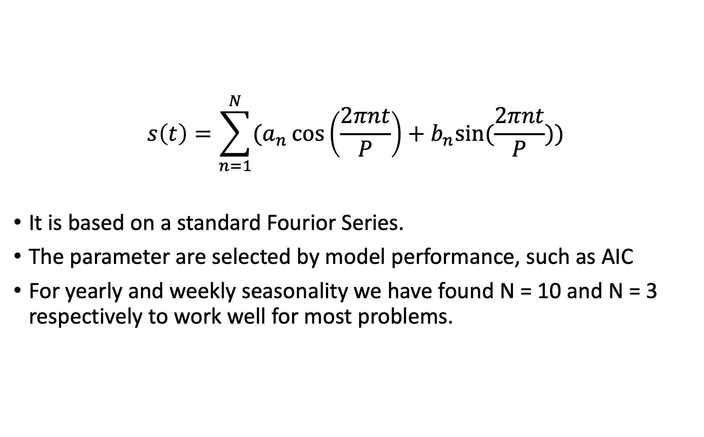
Seasonal Model
$$s\left(t\right)=\sum_{n=1}^{N}{(a_{n}\cos\left(\frac{2πnt}{P}\right)+b_{n}sin⁡(\frac{2πnt}{P}))}$$
It is based on a standard Fourior Series.
The parameter are selected by model performance, such as AIC
For yearly and weekly seasonality we have found N = 10 and N = 3 respectively to work well for most problems.
Notes:
Seasonality is the periodic changes like daily, weekly, or yearly seasonality.

Slide 4
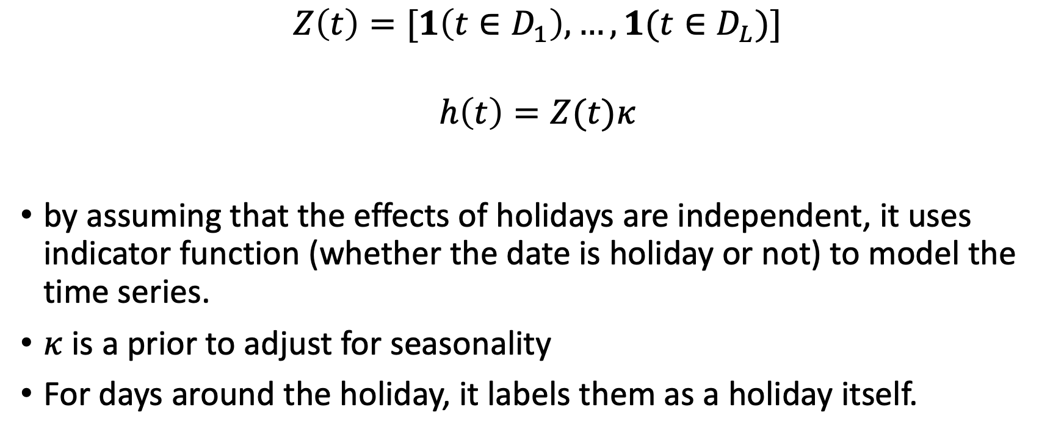
Holiday and Event Model
$$Z\left(t\right)=[1\left(t∈D_{1}\right),…,1(t∈D_{L})]$$
$$h\left(t\right)=Z(t)κ$$
by assuming that the effects of holidays are independent, it uses indicator function (whether the date is holiday or not) to model the time series.
$κ$ is a prior to adjust for seasonality
For days around the holiday, it labels them as a holiday itself.
Notes:
Holiday effects the time series which occur on irregular schedules over a day or a period of days.
It is often important to include effects for a window of days around a particular holiday,
such as the weekend of Thanksgiving. To account for that we include additional parameters for the days surrounding the holiday, essentially treating each of the days in the window around the holiday as a holiday itself.

Slide 5
Advantages
Decompose easily and Fitting of the model is fast
Flexibility: Accommodates seasonality with multiple periods
Intuitive hyper parameters which are easy to tune
Easy to interpret the model
Notes:
/ accommodates new components
the GAM formulation has the advantage that it decomposes easily and accommodates new components as necessary, for instance when a new source of seasonality is identified. GAMs also fit very quickly

Slide 6
Time Series Cross Validation

Slide 7
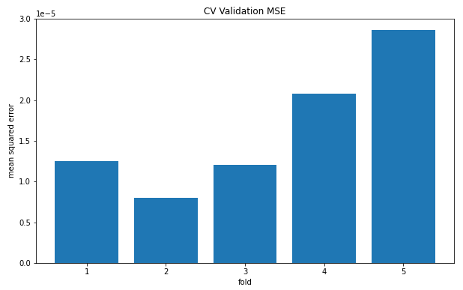
Result – CV performance

Slide 8
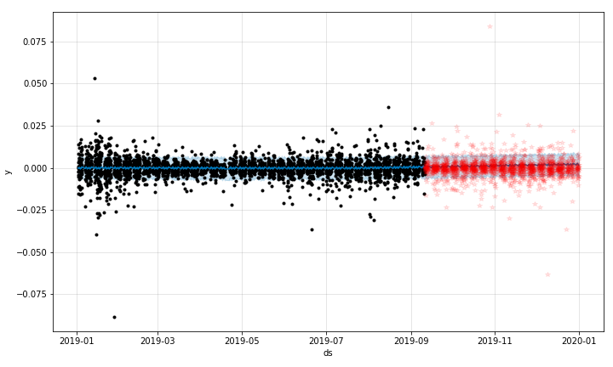
Result – Final Model
r2:
Training: 0.0042
Testing: -0.0035
Notes:
R2: 0.004185531455477176
R2: -0.003531435935840488

Slide 9
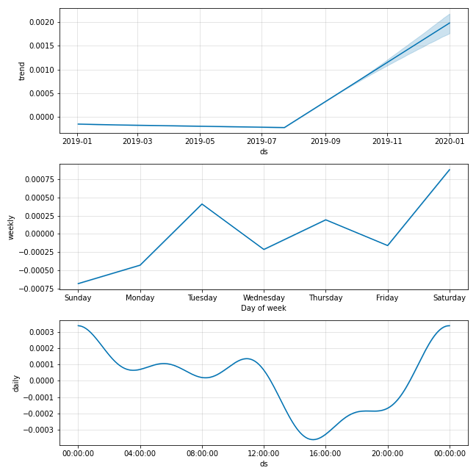
Result – Final Model
Trend
Seasonality (weekly & daily)

Slide 10
Strategy
Long and Short strategy:
Long: when three consecutive prediction of log return are larger than zero
Short: when three consecutive prediction of log return are smaller than zero
Hold: otherwise
If the long signal appears, we buy one unit of BTC. And if the short signal appears, we sell one unit of BTC.
Our deposit starts with 10,000.

Slide 11
Performance in Training Set – Rate of Return: 133.2%
Notes:
Total Return: 13323.6
Return Rate: 1.332
Buy and Hold: 6333.7

Slide 12
Performance in Testing Set – Rate of Return: 41.7%
Notes:
Total Return: 4168.3
Return Rate: 0.417
Buy and Hold: -2935.3

Slide 13
Conclusion
The performance of prophet on log return wasn’t ideal, but it can still make profitable strategy after doing some adjustment.
The result may be different if we take tax and trading cost into account.
Prophet is good at modelling time series with strong seasonality and with critical changing points. Prophet might perform better on market Index, which has an apparent trend.

Slide 14
Reference
Paper: https://peerj.com/preprints/3190/
Package: https://facebook.github.io/prophet/
Medium blog: https://towardsdatascience.com/time-series-prediction-using-prophet-in-python-35d65f626236

